Slide 1
CREDIT CARD FRAUD DETECTION
Boya Zeng
2024 May
https://github.com/Boya-Z/Fraud-Detectoion

Slide 2
— Problem Statement
Credit card fraud represents a significant challenge to financial security and customer trust. The project aims to develop a deep learning model that can effectively identify and classify transactions as fraudulent or legitimate, helping to mitigate losses due to fraud.

Slide 3
Data Overview
The dataset contains transactions made by credit cards in September 2013 by European cardholders.
Dataset Attributes
V1 - V28
Time
Amount
Class
Numerical features that are a result of PCA transformation.
Seconds elapsed between each transaction and the 1st transaction.
Transaction amount.
Fraud or otherwise (1 or 0)
Assumptions about Data
1.The principal components included in the dataset (after PCA transformation) contain sufficient information to identify patterns associated with fraud.
2.The labels in the dataset are accurate and there are no misclassifications.
3.The features even after scaling, retain their predictive value.

Slide 4
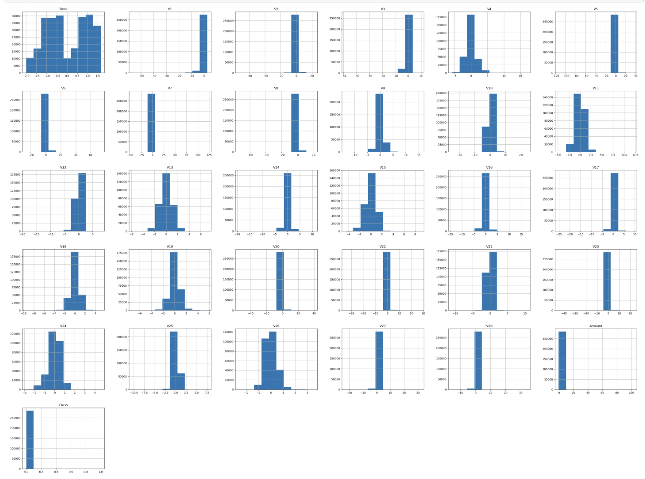
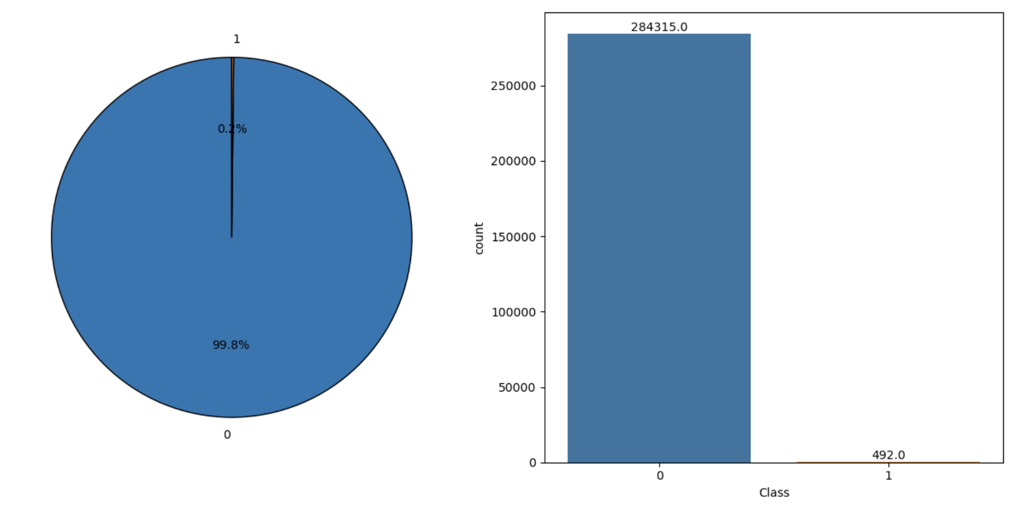
Exploratory Data Analysis
Distribution of Each Variable
Fraud vs Genuine transactions
Dataset Dimension (284807, 31)
No Missing Value Present
The visual analysis of 'Amount' shows a right-skewed distribution, typical for
transactional data, where most transactions involve smaller amounts.
The dataset contains 284,807 transactions, of which only 492 (0.17%)
are fraudulent, indicating a highly imbalanced dataset.

Slide 5
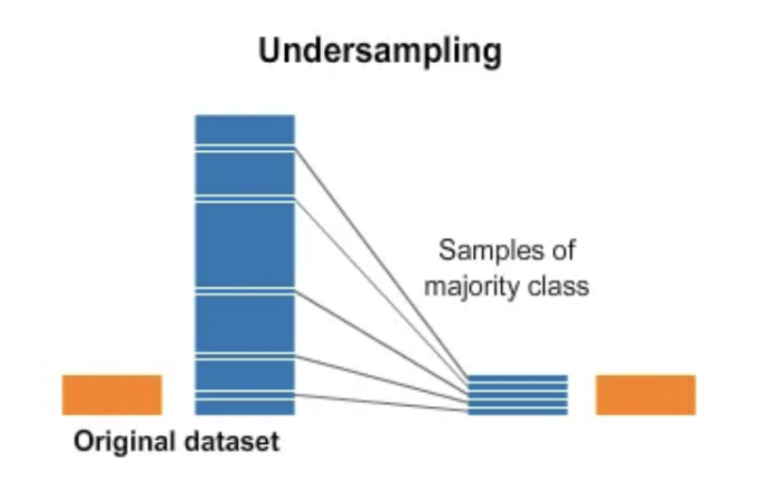
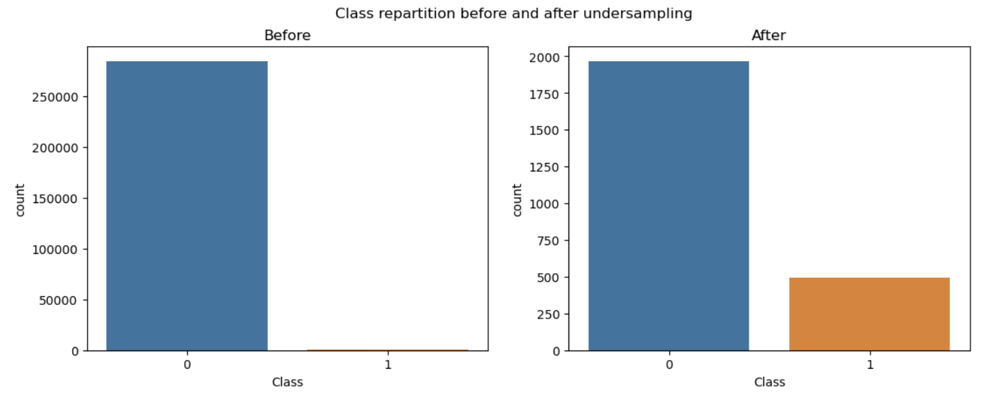
Feature Engineering & Transformations
Step1: Balancing the Dataset--Under-sampling the Majority Class
Step2: Features were scaled using StandardScaler to standardize their range and distribution, which helps improve the learning process of neural networks and CNN.

Slide 6
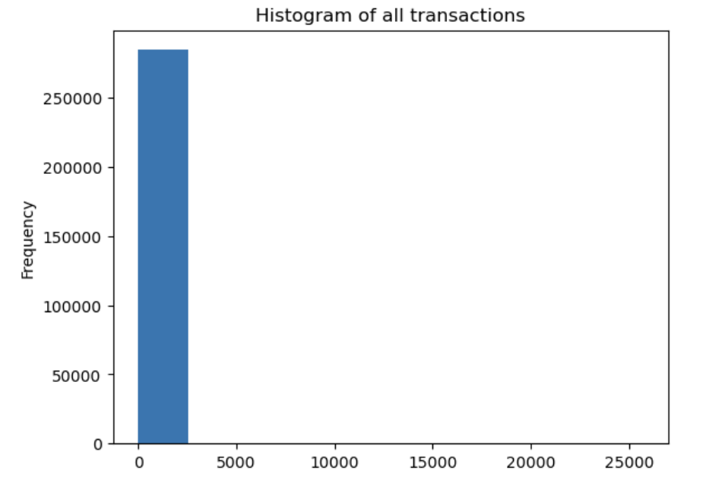
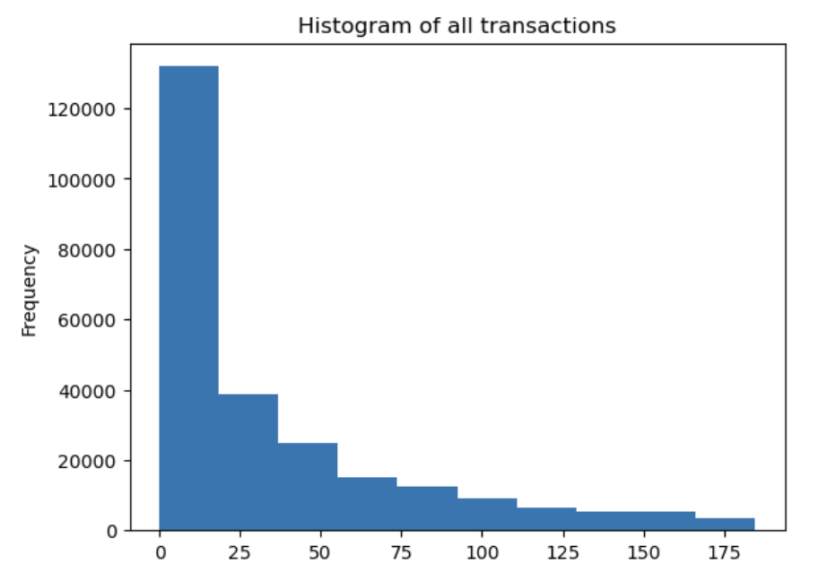
Feature Engineering & Transformations
Step3: Applied the IQR method to remove outliers from the 'Amount' feature.
Step4: Split the data into training and testing sets.
Step5: Reshape the data for compatibility with CNN input requirements.
X_train | y_train | X_test | y_test
(1760, 30) | (1760,) | (441, 30) | (441,)
X_train | X_test
(441, 30, 1) | (441, 30, 1)

Slide 7
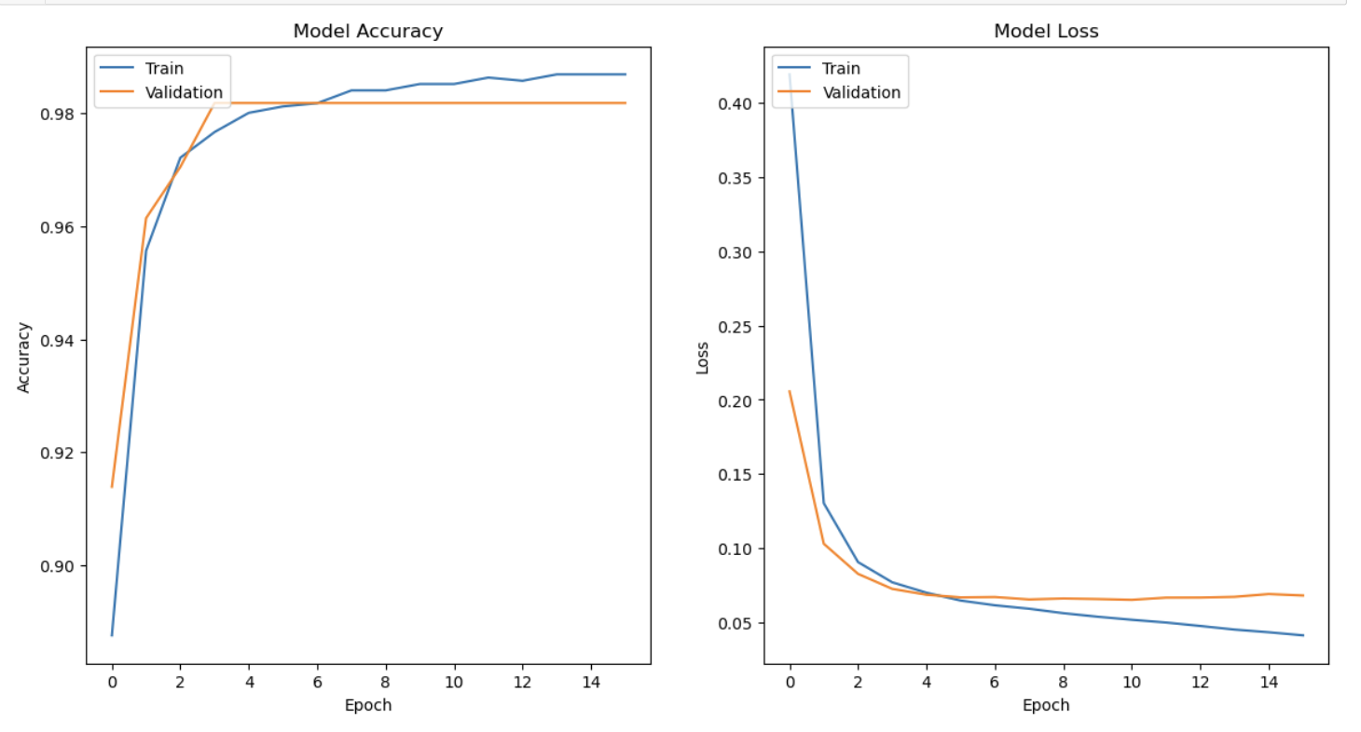
Model with Checks for Overfitting/Underfitting
Model Accuracy Graph:
The training accuracy (blue) and validation accuracy (orange) both increase and converge, indicating that the model is learning effectively from the training data and generalizing well to the validation data.
Both curves plateau around the same accuracy level, showing no significant gap, which suggests minimal overfitting.
Model Loss Graph :
loss (orange) decrease initially, indicating that the model is learning to reduce error.
The validation loss starts to plateau and even slightly increase after a certain number of epochs, which is a sign of potential overfitting. However, early stopping helps to mitigate this by stopping training once the validation loss ceases to improve.
Multilayer Neural Network

Slide 8
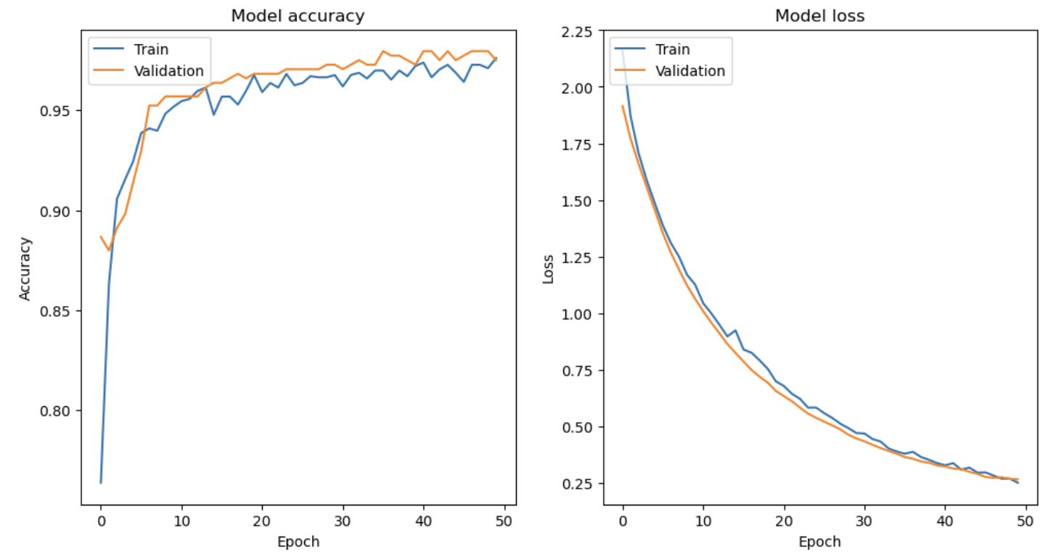
Model with Checks for Overfitting/Underfitting
Model Accuracy Graph:
The training accuracy (blue) and validation accuracy (orange) both increase and converge, indicating that the model is learning effectively from the training data and generalizing well to the validation data.
Both curves plateau around the same accuracy level, showing no significant gap, which suggests minimal overfitting.
Model Loss Graph :
The training loss (blue) and validation loss (orange) decrease initially, indicating that the model is learning to reduce error.
The validation loss starts to plateau and even slightly increase after a certain number of epochs, which is a sign of potential overfitting. However, early stopping helps to mitigate this by stopping training once the validation loss ceases to improve.
Convolutional Neural Network (CNN)

Slide 9
Model Selection with Regularization
Neural Network
CNN
Dropout layers to prevent overfitting.
L2 regularization to penalize large weights.
Batch normalization to stabilize learning.
Keras Tuner is used to perform Random Search on the hyperparameters. The best model is selected based on validation accuracy.
Early stopping is used during the search to prevent overfitting.
CNN model selected based on Bayesian Optimization results.
Model trained with early stopping and the best hyperparameters found.
Regularization Techniques

Slide 10
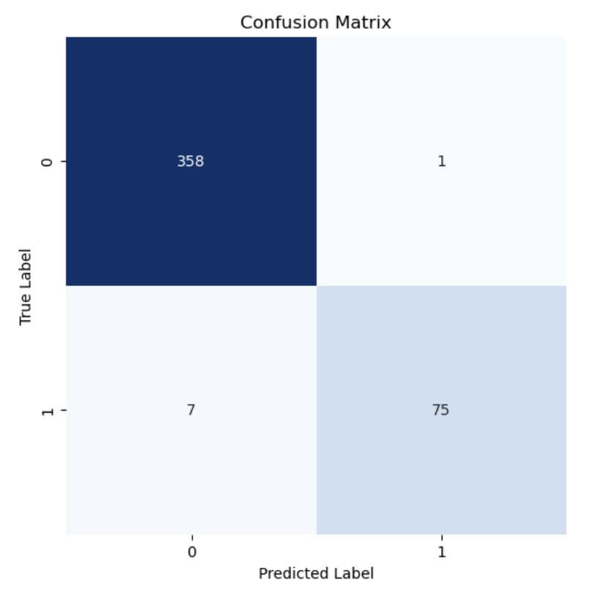
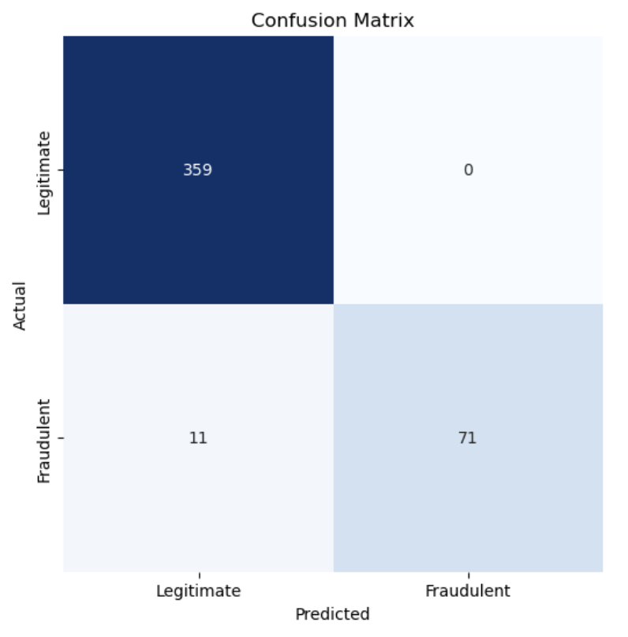
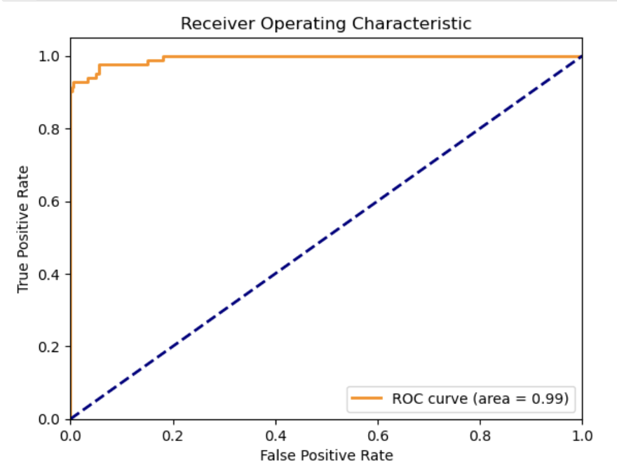
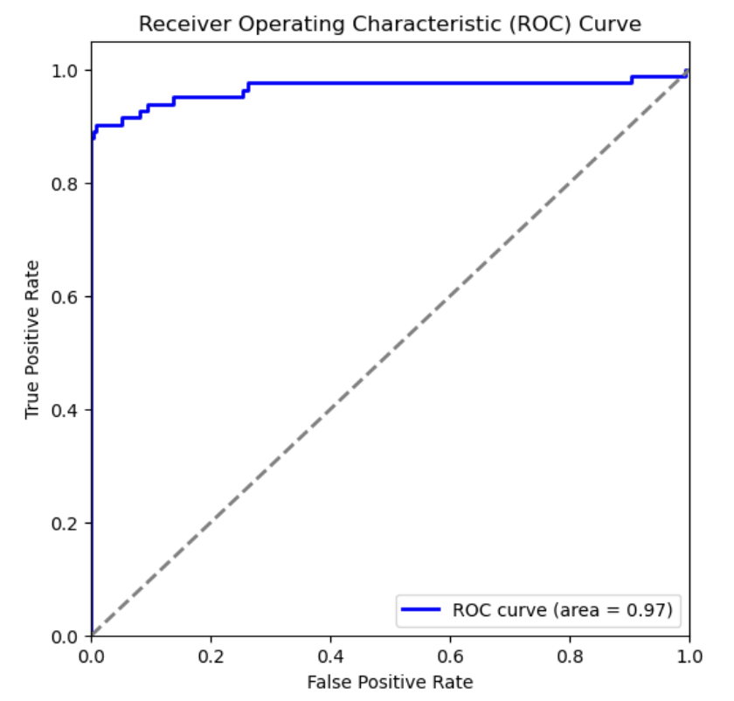
Results and Learnings from the Methodology
NN
CNN
Model Selection:
The NN model may be preferred in scenarios where a balance between false positives and false negatives is crucial.
The CNN model may be preferred in scenarios where minimizing false positives is more critical, despite a slight increase in false negatives.
The ROC curves for both models indicate excellent performance, with AUC values close to 1.

Slide 11
Results and Learnings from the Methodology
 | NN | CNN
Accuracy | 0.9818 | 0.9750
Precision | 0.9868 | 1.0
Recall | 0.9146 | 0.8659
F1-Score | 0.9493 | 0.9281
Learning
The accuracy and F1-score were high for both models, demonstrating their effectiveness in classifying transactions as fraudulent or legitimate.
The NN model had a slightly higher F1-score, indicating a better balance between precision and recall.
The CNN model achieved perfect precision, meaning it did not classify any legitimate transactions as fraudulent, which is critical in financial fraud detection.
Early stopping and regularization were crucial in ensuring the models did not overfit the training data.
Conclusion
The NN model may be preferred when a balance between false positives and false negatives is crucial, as it provides high recall and F1-score.
The CNN model may be preferred in scenarios where minimizing false positives is more critical, despite a slight increase in false negatives, due to its perfect precision.

Slide 12
Future Work
01
Explore other deep learning architectures, such as Recurrent Neural Networks (RNNs) or Transformer models, to potentially improve performance.
Options
02
Explore other feature engineering techniques, such as creating interaction terms or more sophisticated time-related features.
Options
03
Implement more advanced techniques for handling imbalanced data, such as SMOTE (Synthetic Minority Over-sampling Technique).
Options
04
Continuous learning and model updating with new transaction data to adapt to emerging fraud patterns.
Options

Slide 13

Thanks

